Slide 1
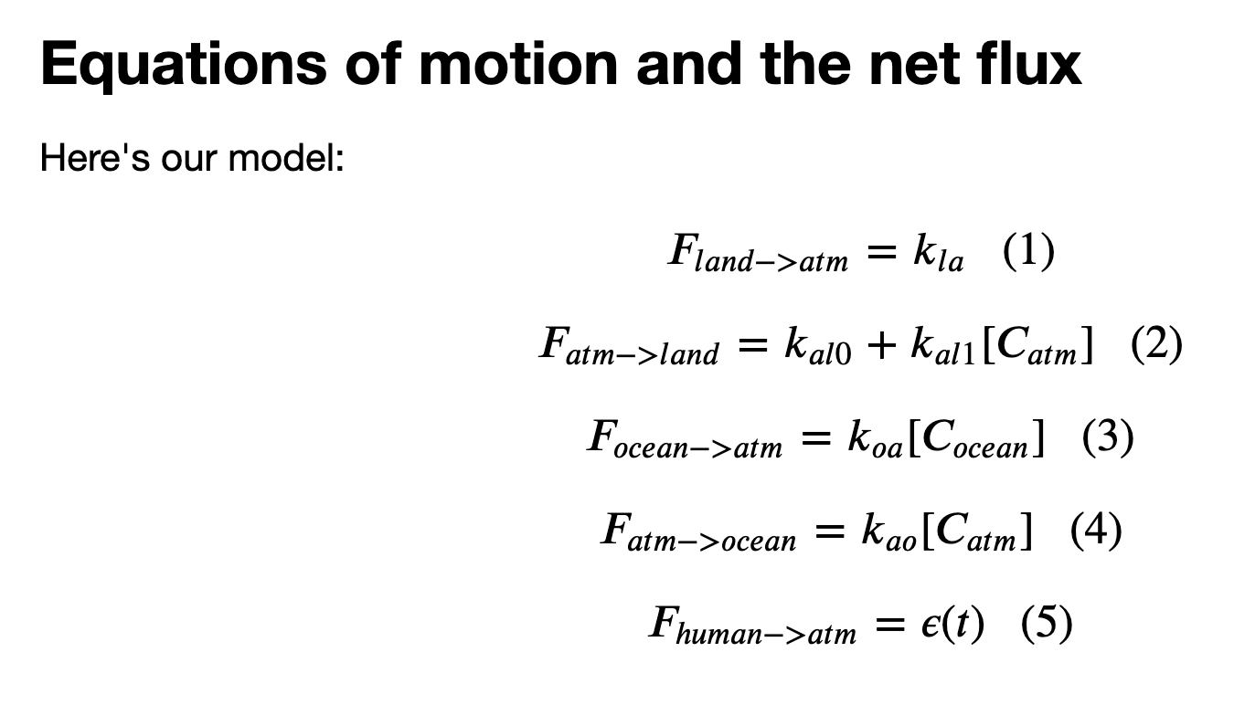
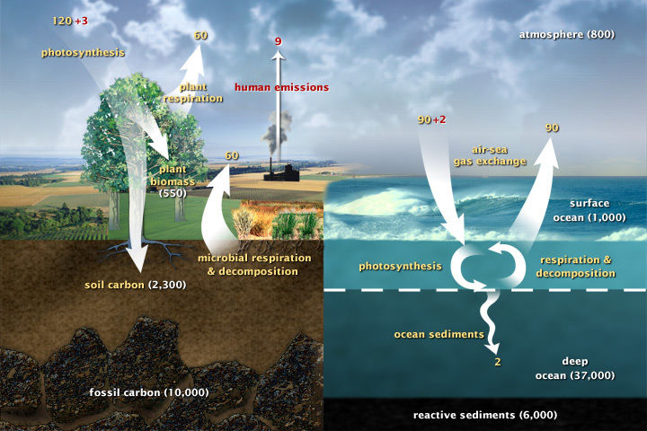
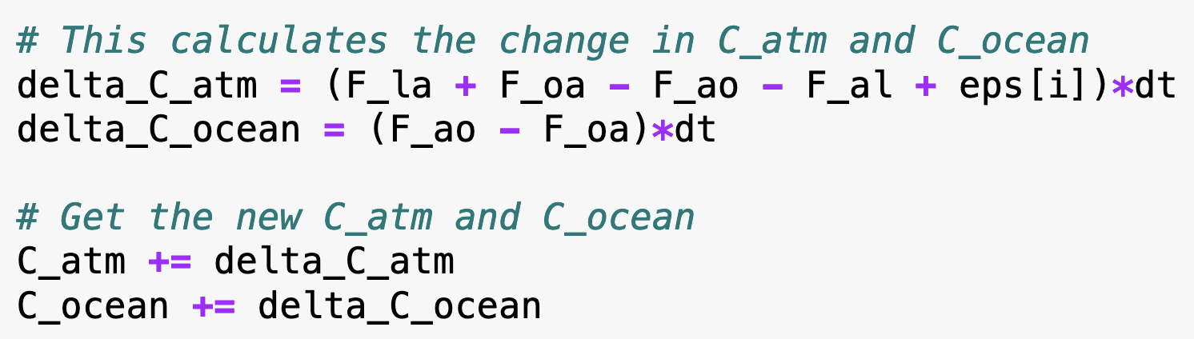
Recap: Cambio1.0
In an Euler loop, we calculated fluxes
From the fluxes we found changes in the amount of carbon in the atmosphere and oceans:

Slide 2
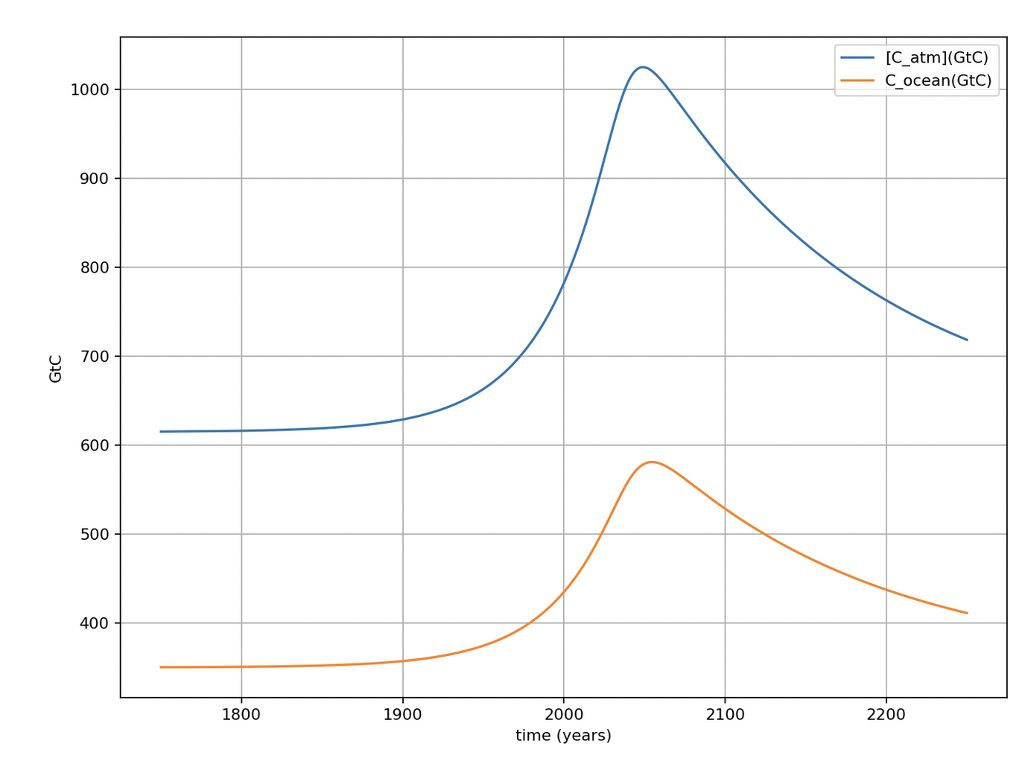
That led to a timeline of amounts in the atmosphere and the upper ocean
Pre-industrial carbon amounts

Slide 3
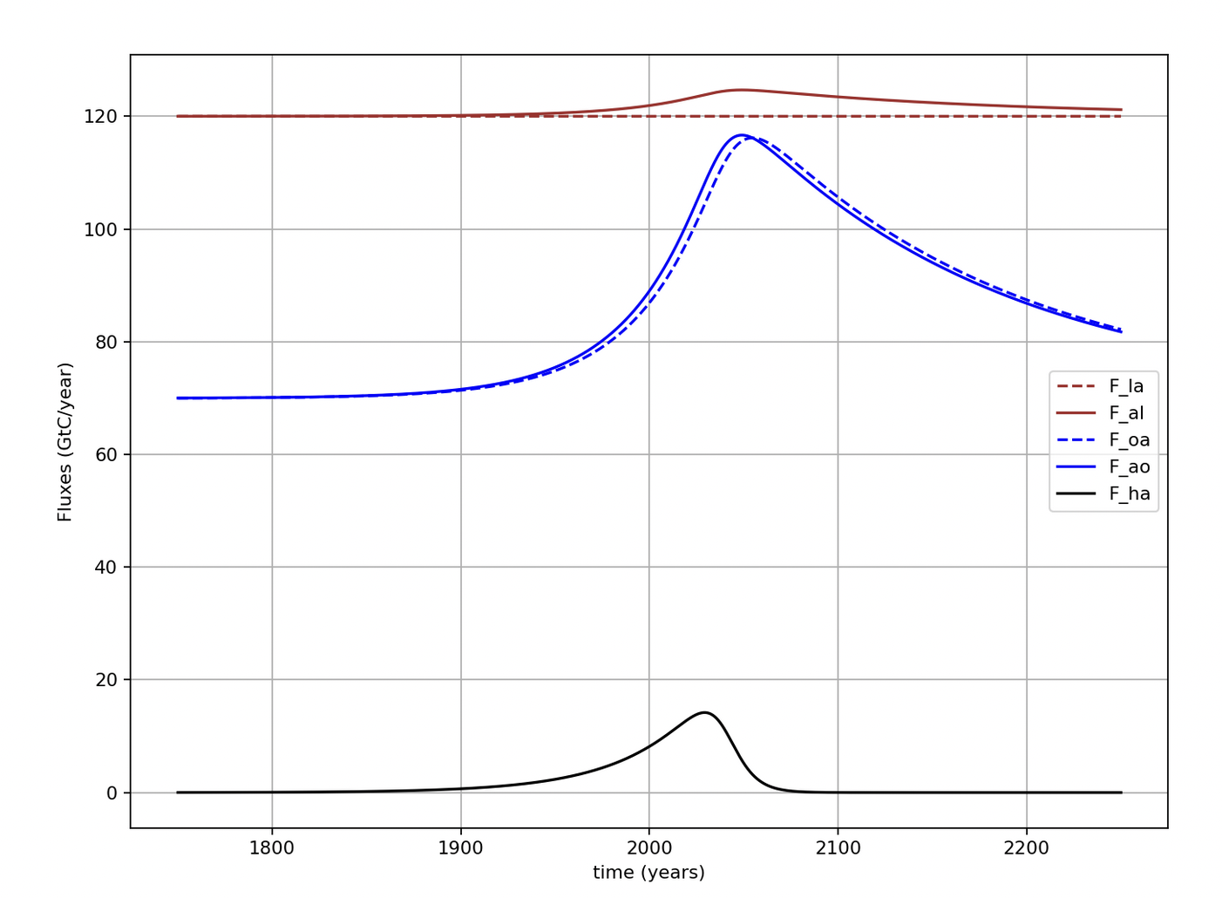
We’ve also looked at net atm/ocean fluxes

Slide 4
And at net atm/land fluxes

Slide 5
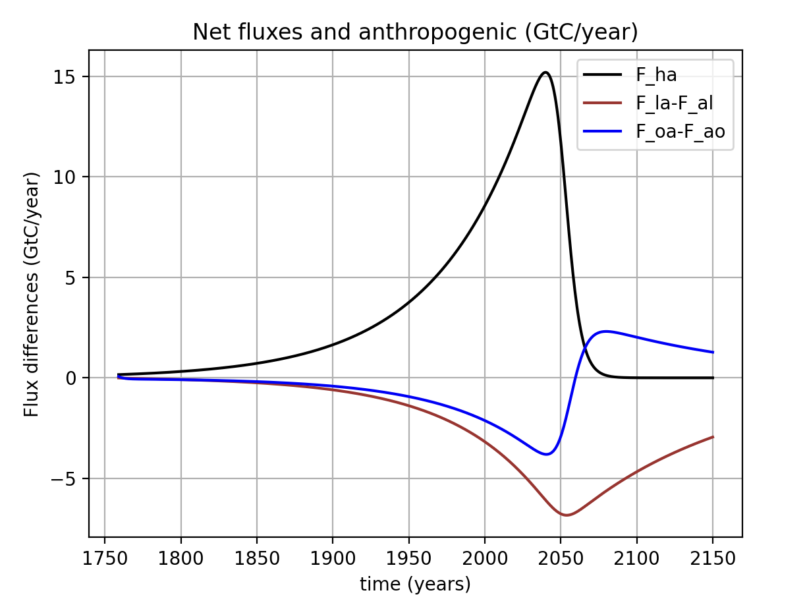
For decades, observations have shown (and Cambio agrees) that the combined net flux (land and oceans) has been about ½ of the annual anthropogenic flux to atmosphere
We can say that these sinks are Earth’s ”free” ecosystem service. How long will it last? See the Discussion assignment.

Slide 6
Cambio also predicts that oceans are not a permanent sink, but rather temporary storage.
This reversal is because the climate seems to be on a path back to something like pre-industrial: As carbon amounts in the atmosphere return to normal, the supersaturated oceans begin to give up some of their excess carbon.
Oceans become a net source of carbon around mid-century
Peak backlash (net ocean-to-atmosphere flux is a maximum)
Pre-industrial carbon amounts

Slide 7
Plan for the day
Talk about the difference between kinds of variables in Cambio 1.0: parametric, prognostic, and diagnostic
Introduce two functions that create Python dictionaries to help keep things organized:
GetMyScenario
CreateClimateParams
Set up functions to calculate (“diagnose”) variables.

Slide 8
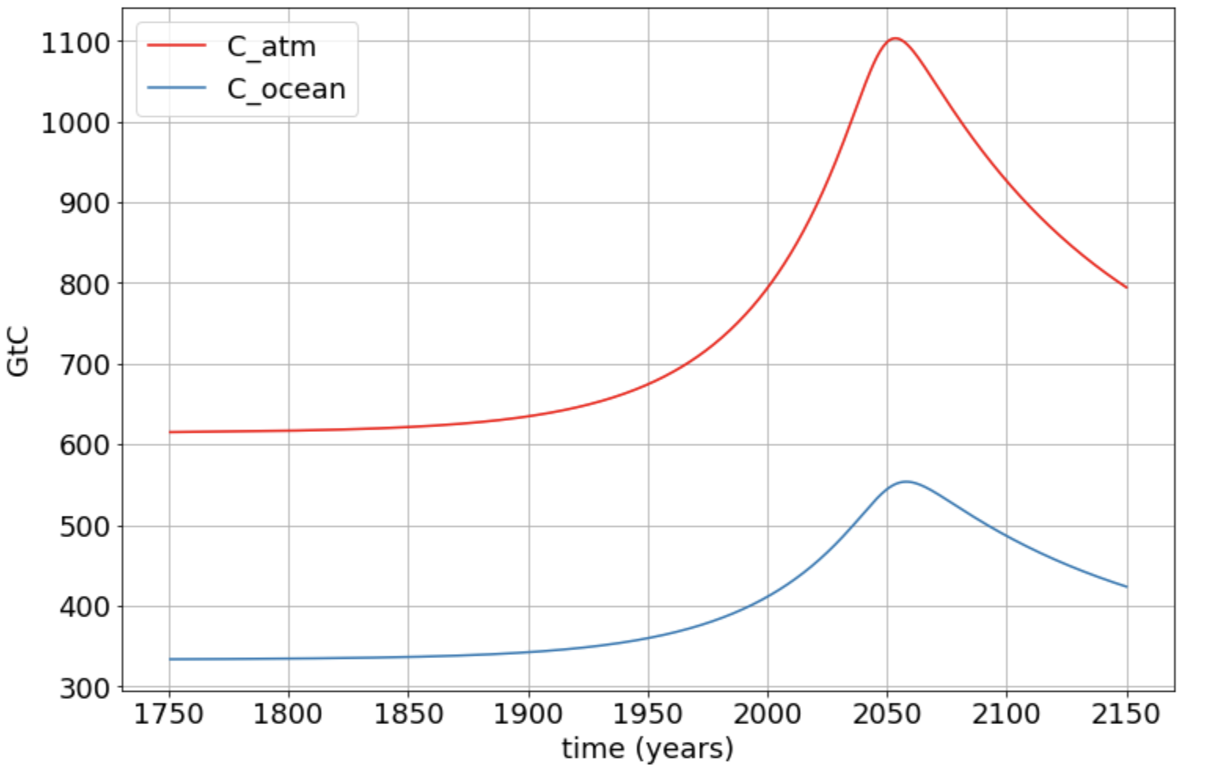
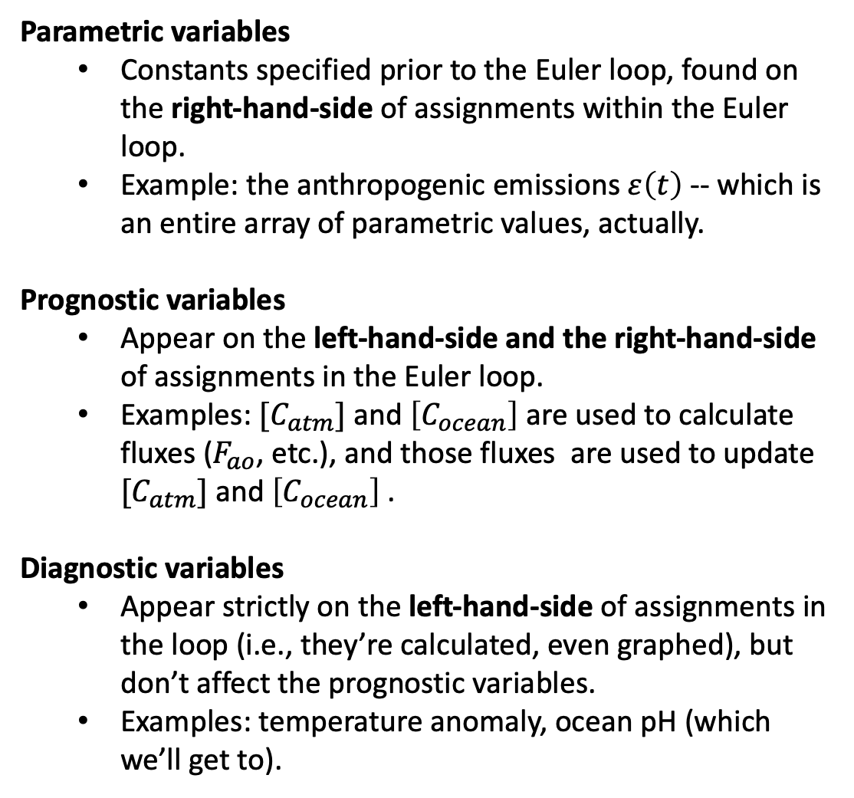
Different kinds of quantities in Cambio 1.0
Parametric variables
Constants specified prior to the Euler loop, found on the right-hand-side of assignments within the Euler loop.
Example: the anthropogenic emissions $ε\left(t\right)$ -- which is an entire array of parametric values, actually.
Prognostic variables
Appear on the left-hand-side and the right-hand-side of assignments in the Euler loop.
Examples: $[C_{atm}]$ and $\left[C_{ocean}\right]$ are used to calculate fluxes ($F_{ao}$, etc.), and those fluxes are used to update $[C_{atm}]$ and $\left[C_{ocean}\right]$.
Diagnostic variables
Appear strictly on the left-hand-side of assignments in the loop (i.e., they’re calculated, even graphed), but don’t affect the prognostic variables.
Examples: temperature anomaly, ocean pH (which we’ll get to).

Slide 9
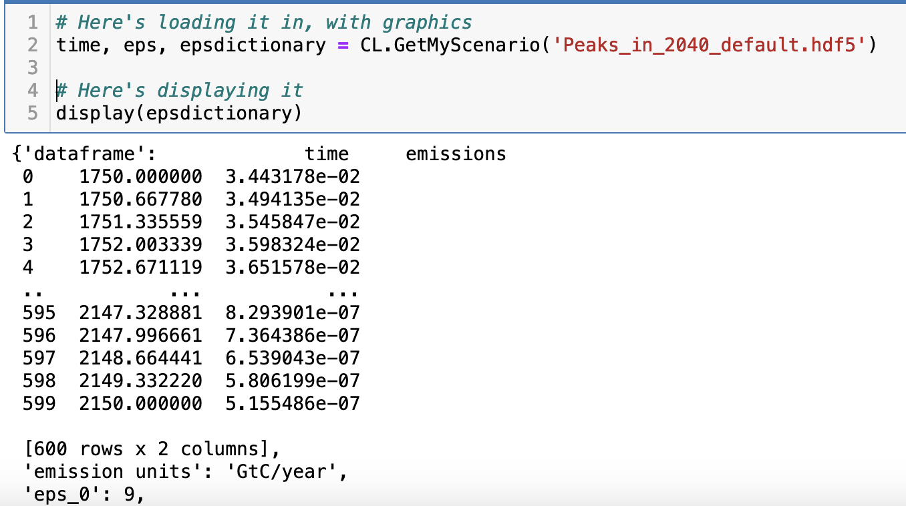
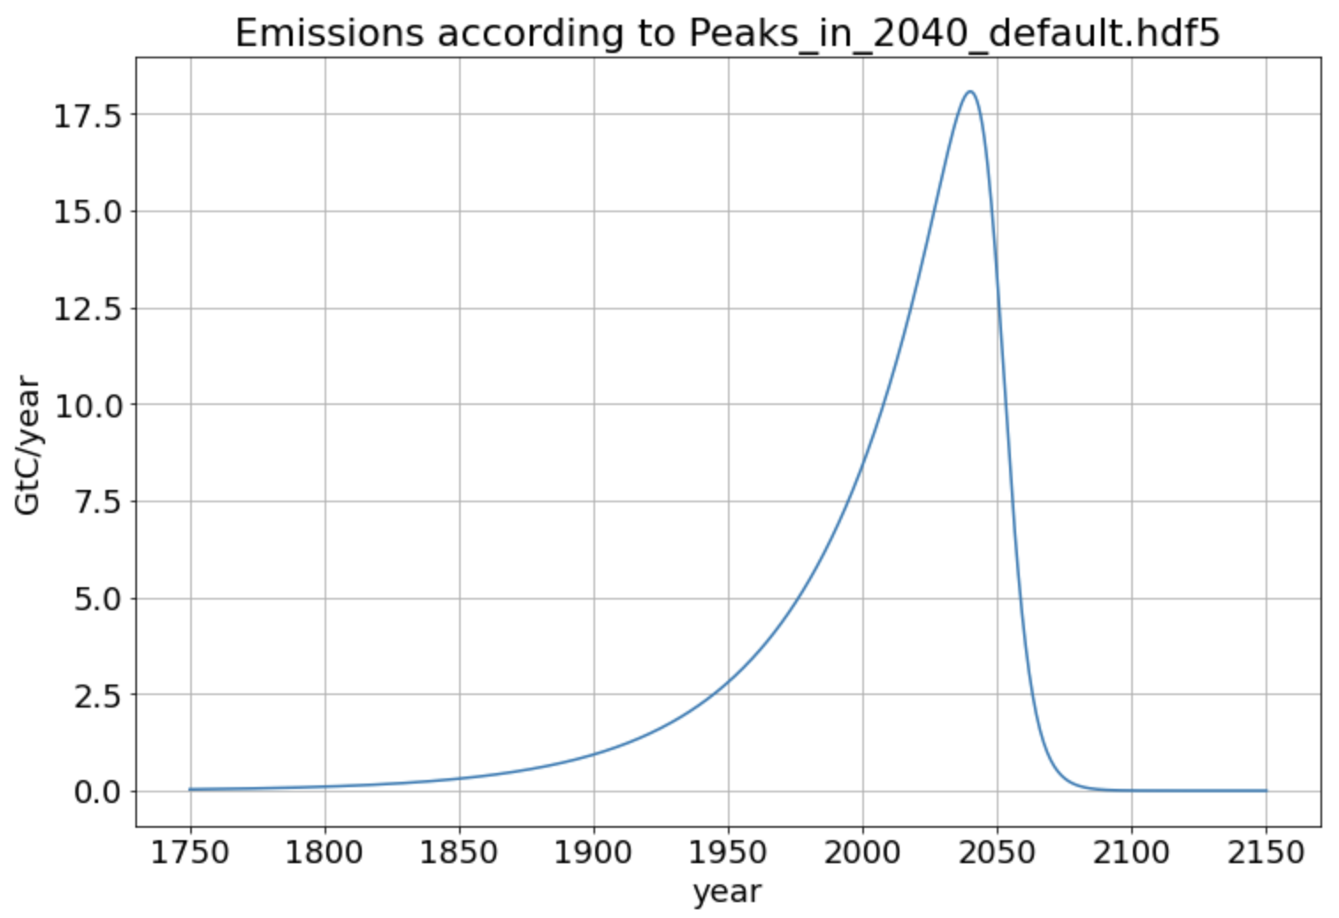
GetMyScenario: a function that loads in your emission scenario!

Slide 10
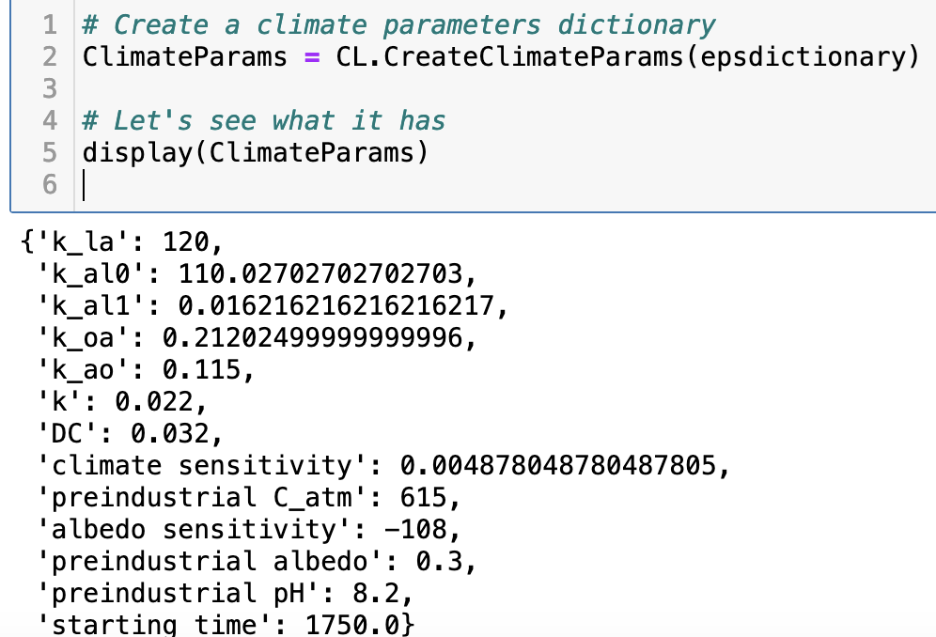
CreateClimateParams: a function that creates a “dictionary” to help keep things organized
It’s customizable too ... As you’ll see

Slide 11
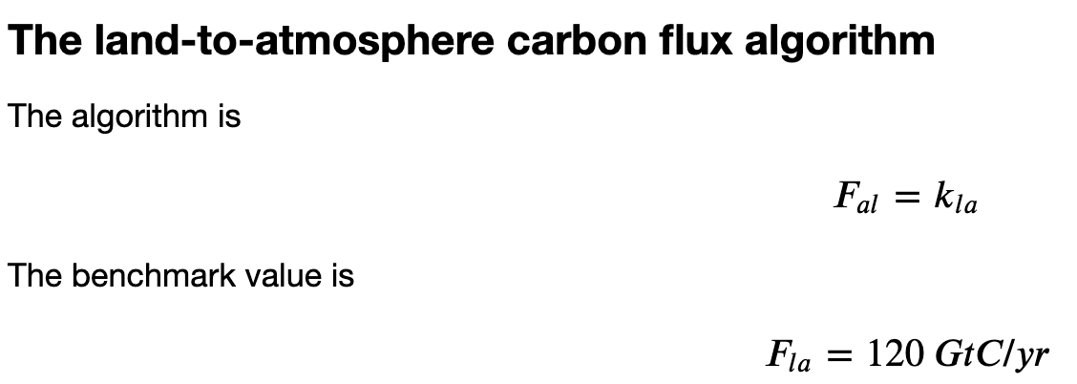
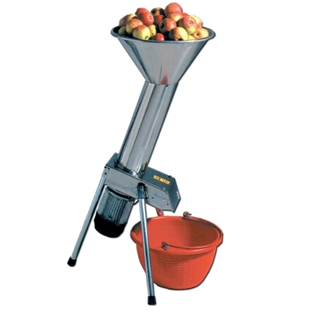
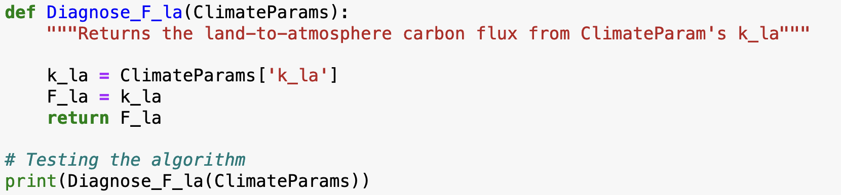
Setting up diagnostic functions: F_la
ClimateParams goes in
F_la comes out

Slide 12
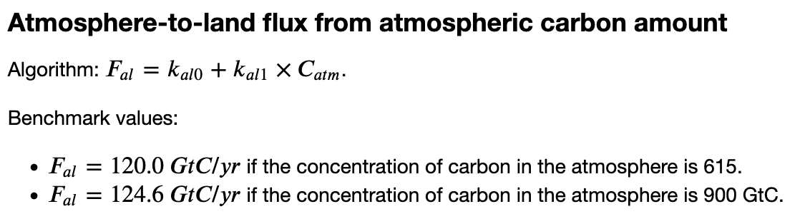
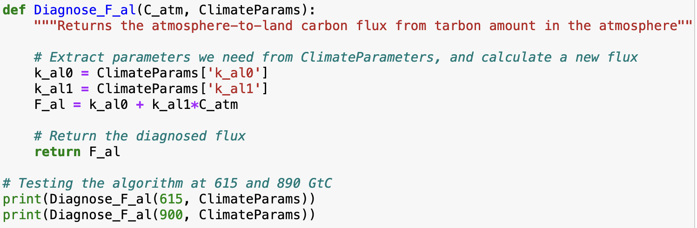
Setting up diagnostic functions: F_al
C_atm and ClimateParams go in
F_al comes out

Slide 13
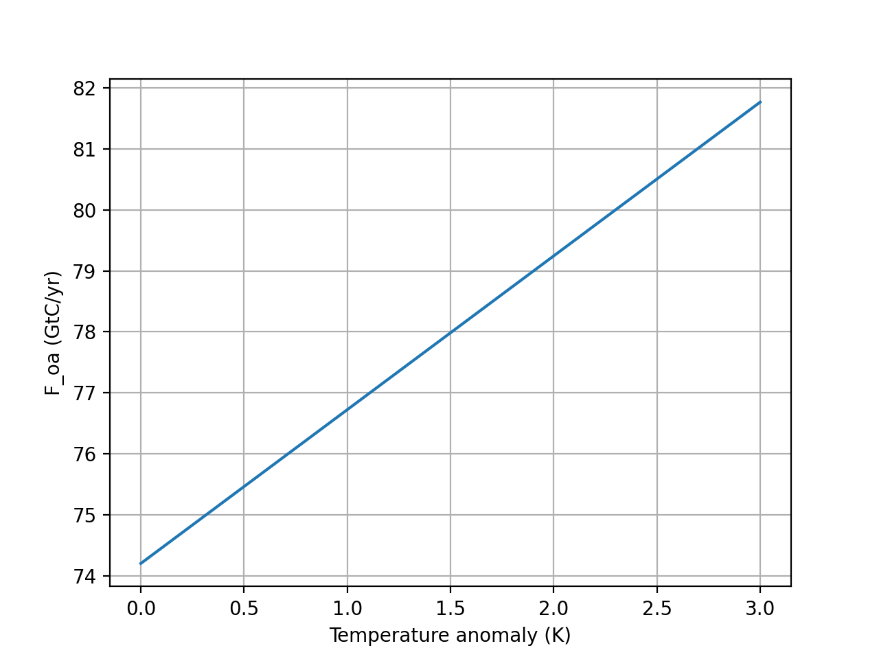



Here’s a challenging one: a temperature-dependent F_oa
$$F_{ocean→atm}=k_{oa}×(1+T_{anomaly}×DC)[C_{ocean}]$$
This allows for faster outgassing at higher temperature.
$$F_{ocean→atm}$$
$$T_{anomaly}$$
Cold ocean
Warm ocean

Slide 14
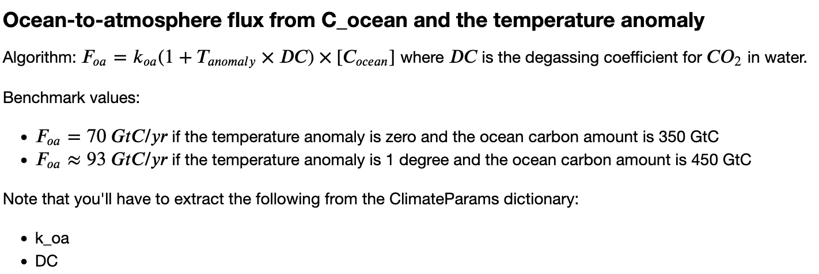
Here’s a challenging one: a temperature-dependent F_oa
C_ocean and ClimateParams go in
F_oa comes out
120

Slide 15
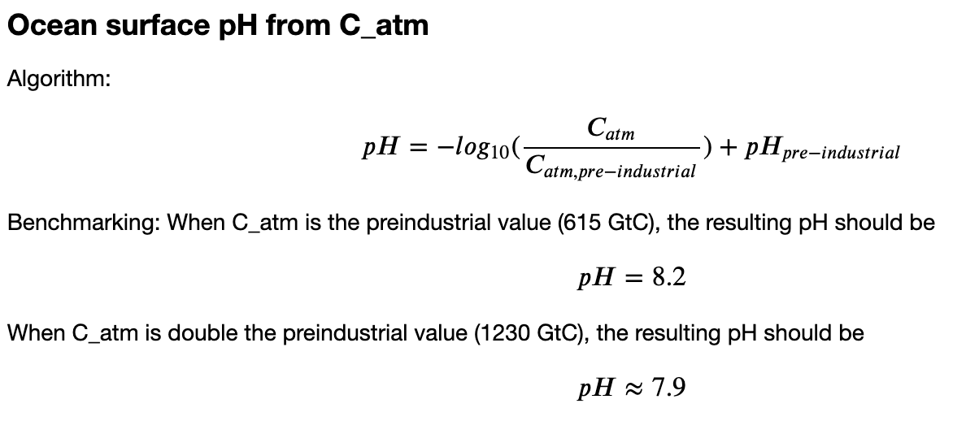
Setting up diagnostic functions: ocean pH
C_atm and ClimateParams go in
pH comes out
(And a few others)

Slide 16
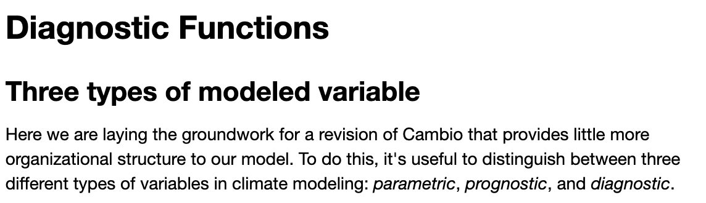
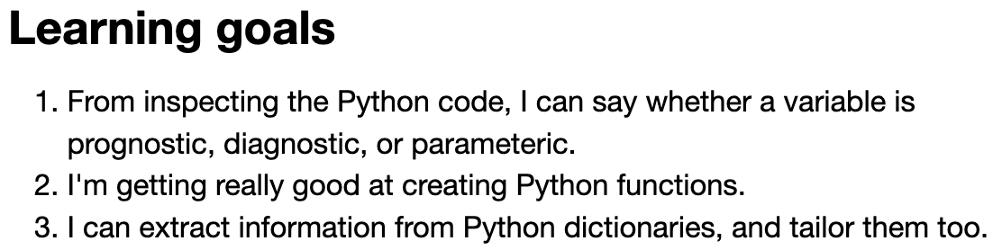
OK, let’s get started …

